Slide 1
Keyword Extraction
Fatjon ZOGAJ

Slide 2
General Information
Extraction bigger input size
Social Media data HEAVEN
Pre-Labelled Keywords
NLP text analysis
Notes:
I have decided on taking the problem Keyword Extraction with the project type: Bring your own Method. I‘ve chosen this subfield of Natural Language Processing as it combines multiple problems like semantics/translation/summarization etc Keyword Extraction: usually depends on bigger input size -> semantic meaning can more easily transcribed if more information is contained within the input
Social Media contains a lot of personal data which may be of interest for business purposes. One could use this for Marketing or strategy purposes and base this off current trends.
Thus I decided to use Tweets as my data as Hashtags offer already pre labelled data. 1. limited input size (280 characters) 2. hashtags imitate keywords very well 3. perfect fit for marketing purposes

Slide 3
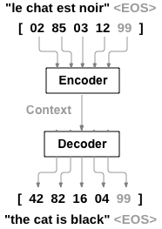
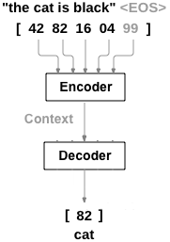
Sequence to Sequence Model
Notes:
In the Sequence to Sequence Model you can use Neural Networks to translate from French to English for example.
Two recurrent neural Network work together to transform one sequence to another. The encoder condenses an input sequence into a vector and the decoder network unfolds the vector into a new sequence.
I have asked myself if this could be used to translate a sentence to its respective keywords.

Slide 4
Insights
50 % accuracy score on validation set
(did not work as well for self formulated tweets though)
highly domain specific
network picked up on underlying semantic meaning
Notes:
Before we go on with a little demo, I wanna summarize a few main points and my key findings.
Using the Encoder Attention Decoder Network I was able to achieve results which were pretty good in my opinion.
I‘ve achieved a validation accuracy score of around 50% which is a pretty good start I‘d say.
Testing this on self formulated tweets though, it unfortunately failed pretty badly. This can be explained by the fact that even though the training and validation data are different, they carry similar underlying topics. The tweets were taken around the time when Black Lives Matter or some contest from Ariana Grande were trending so both training and validation have a similar structure.
Another funny thing to note was that even though I did not use a pre trained embedding and just one hot encoded my dictionary, the network picked up on semantic meaning.

Slide 5
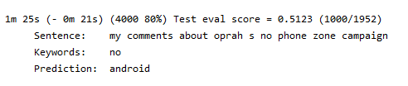
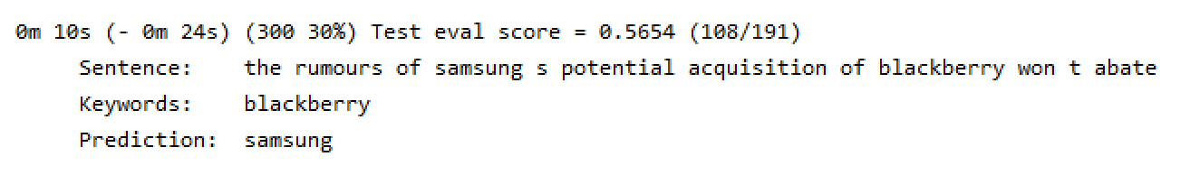
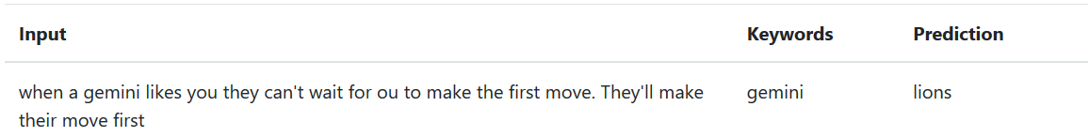
Interesting Findings

Slide 6

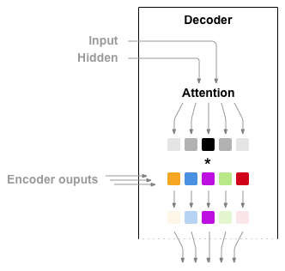
Attention Mechanism
Notes:
Another thing I did, was to use an Attention Decoder which basicallyJ

